Slide 1
Exceptional Handling

Slide 2
Agenda
What is exception
Class Hierarchy
Exceptional Handling Key words
Checked and Unchecked Exception
User Defined Exception
Exception handling in Spring

Slide 3
What is Exception
An exception is an event, which occurs during the execution of a program, that disrupts the normal flow of the program's instructions.
A Java Exception is an object that describes the exception that occurs in a program

Slide 4
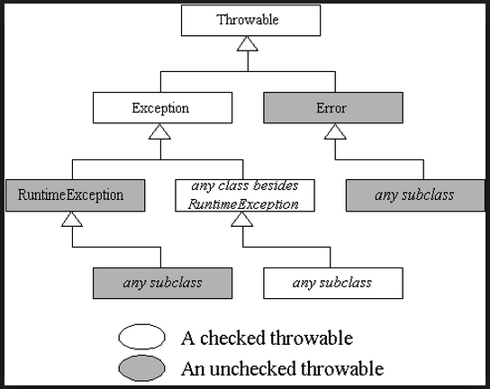
Class Hierarchy

Slide 5
Exception handling Key words
Try
Catch
Finally
--------
Throw
Throws

Slide 6
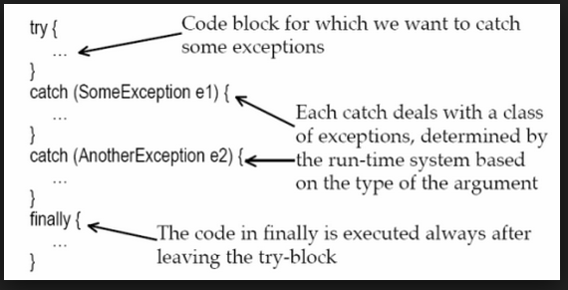
Try – catch - finally

Slide 7
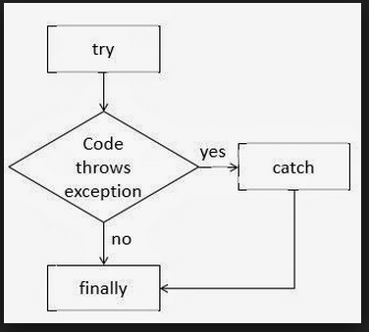
Try – catch – finally flow

Slide 8
DEMO

Slide 9
Spring Exception Handling
Controller Based
@ExceptionHandler annotation
Global Exception Handler
@ControllerAdvice

Slide 10
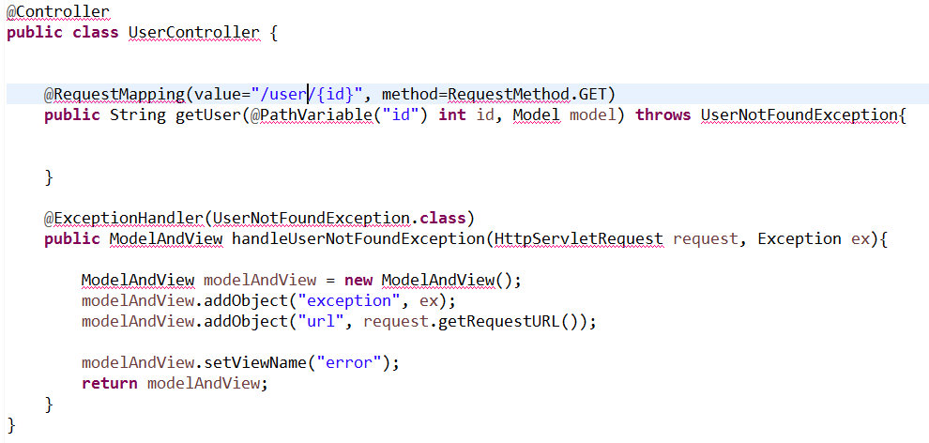
Controller Based

Slide 11
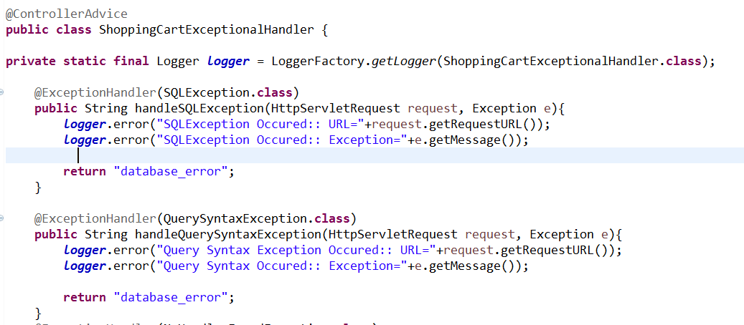
Global Exception Handler
@ControllerAdvice

Slide 12
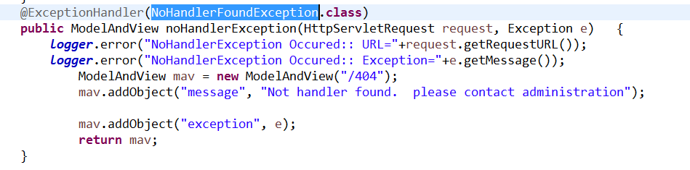
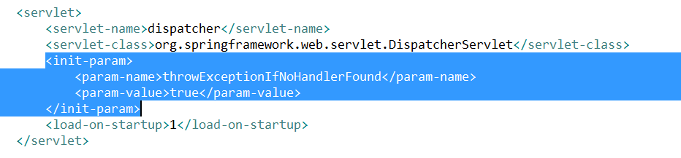
NoHandlerFoundException

